Slide 1
Using the PowerPoint picture cards:
Switch to “Slide Show
Choose “From Beginning”
(or advance to desired picture and choose “From
Current Slide” if you don’t want to start with the
first picture)
Click to advance to the first picture.
Click again to remove picture.
Click again to make the word appear.
Click again to advance to the next picture.

Slide 2
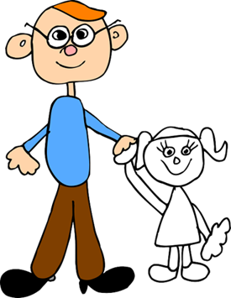
d a d

Slide 3
c a n

Slide 4
v a n

Slide 5
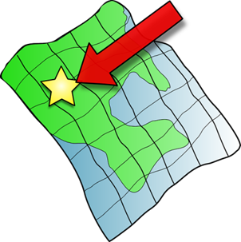
m a p

Slide 6
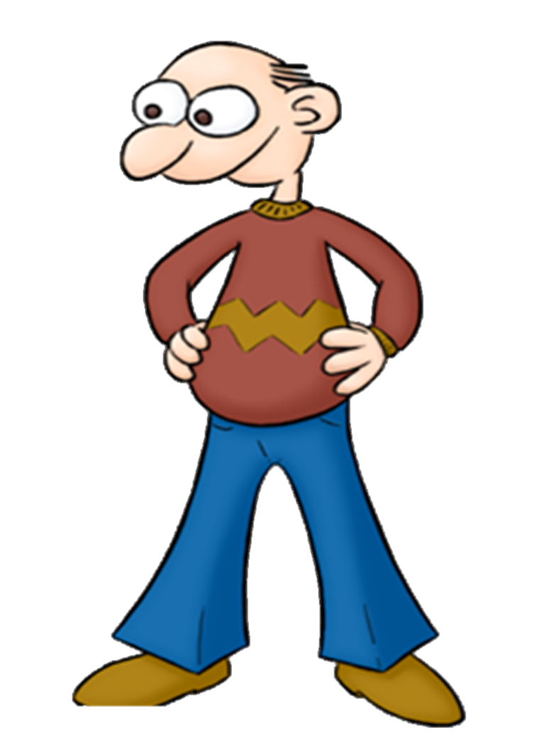
m a n

Slide 7
b a g

Slide 8
b a g

Slide 9
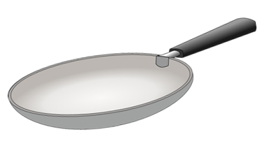
p a n

Slide 10
c a p

Slide 11
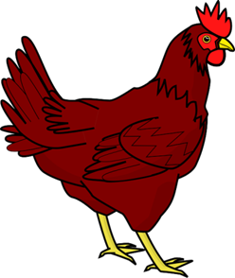
h e n

Slide 12
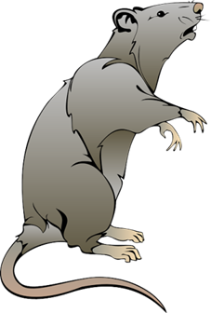
r a t

Slide 13
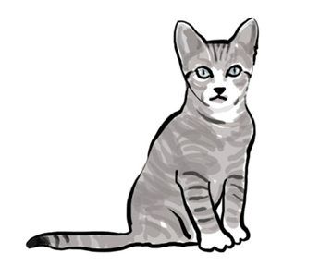
c a t

Slide 14
b a t

Slide 15
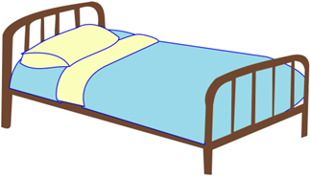
b e d

Slide 16
p e n

Slide 17
t e n

Slide 18
l e g

Slide 19
h a t

Slide 20
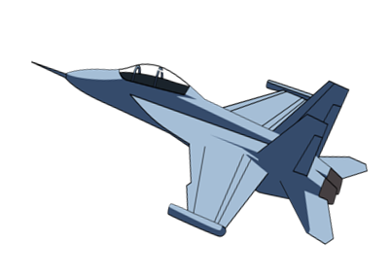
j e t

Slide 21
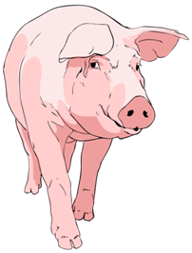
p i g

Slide 22
f i n

Slide 23
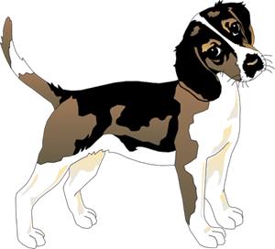
d o g

Slide 24
w i g

Slide 25
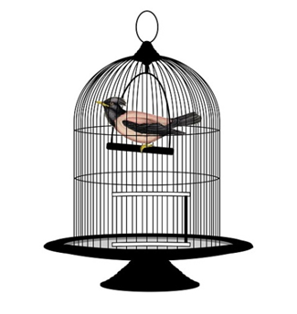
p e t

Slide 26
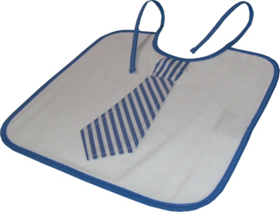
b i b

Slide 27
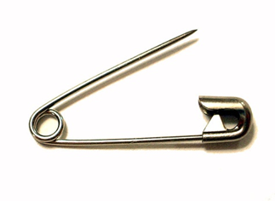
p i n

Slide 28
l o g

Slide 29
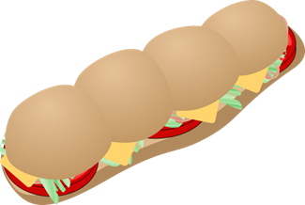
s u b

Slide 30
d o t

Slide 31
f o g

Slide 32
m o p

Slide 33
p o p

Slide 34
c u b

Slide 35
b u g

Slide 36
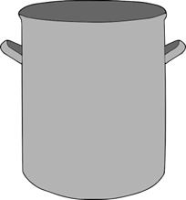
p o t

Slide 37
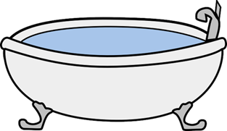
t u b

Slide 38
g u m

Slide 39
h u t

Slide 40
j u g

Slide 41
m u g

Slide 42
b u n

Slide 43
c u t

Slide 44
n u t

Slide 45
s u n

Slide 46
r u g

Slide 47
Cards for printing and choice activities
Print the following slides and cut into individual cards.
Write the word on the back.
Alternatively, use on the screen to help your child make choices in certain activities described.

