Slide 1
Occupational Therapy
at DSRF

Slide 2
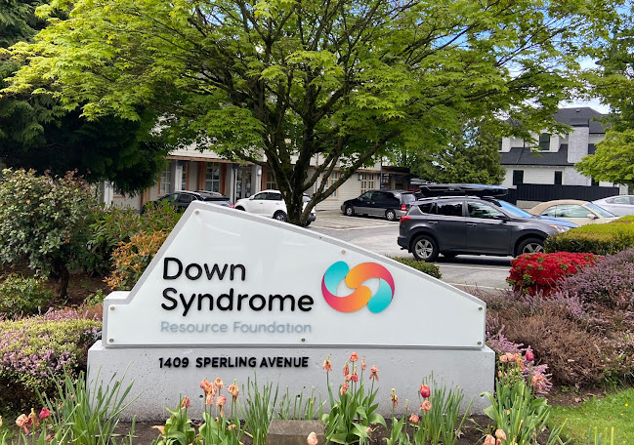
The Down Syndrome Resource Foundation has lots of programs and therapies.
Down Syndrome Resource Foundation | OT

Slide 3
A front desk assistant greets everyone coming into DSRF.
Down Syndrome Resource Foundation | OT

Slide 4
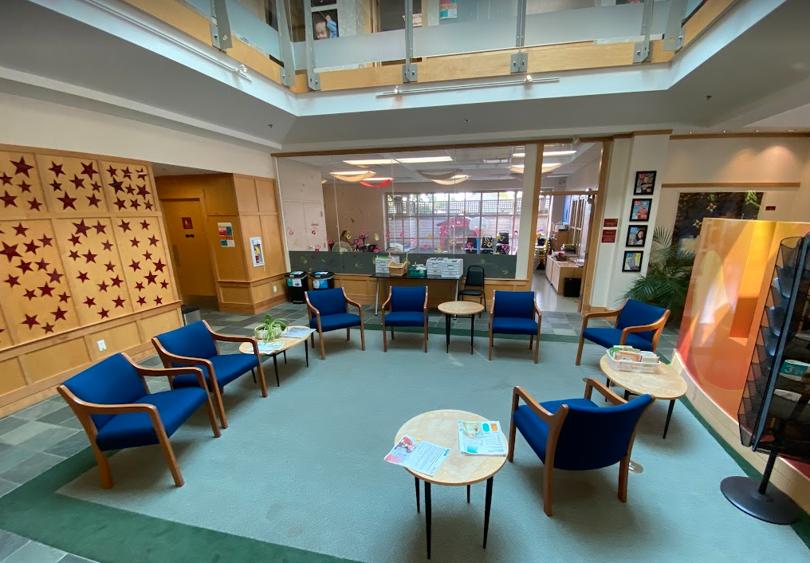
The lobby is where people wait for their occupational therapist.
Down Syndrome Resource Foundation | OT

Slide 5
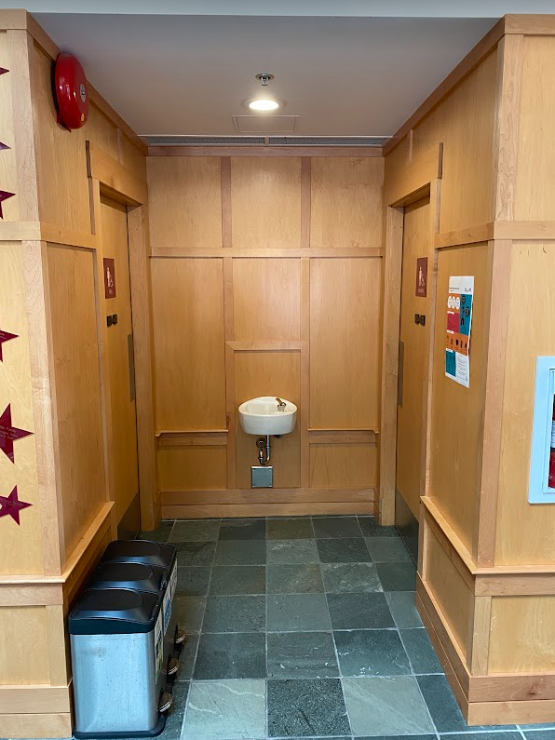
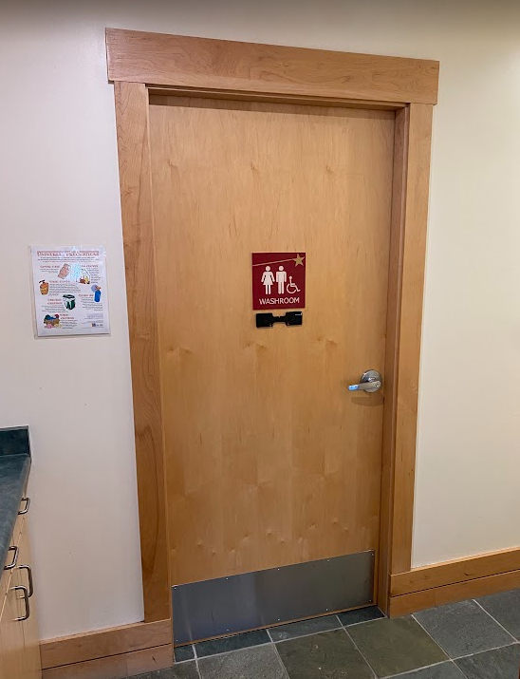
There are gendered washrooms and a large family washroom on the main floor.
Down Syndrome Resource Foundation | OT

Slide 6
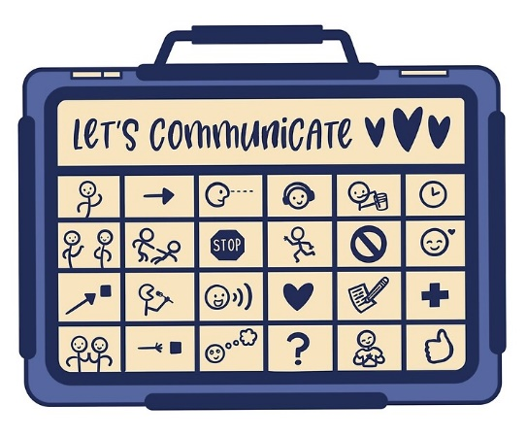
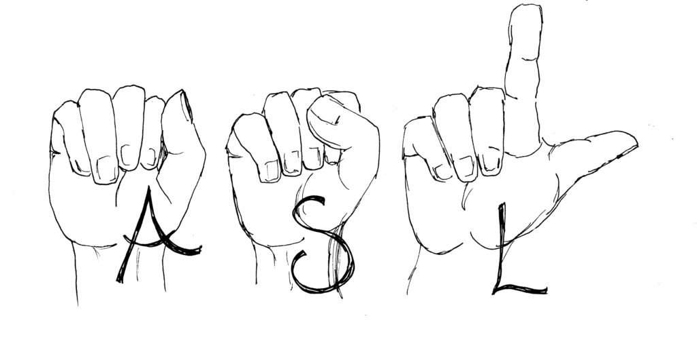
People who come to DSRF use all different kinds of communication. Curiosity is encouraged!
Down Syndrome Resource Foundation | OT

Slide 7
When it’s appointment time, clients will see their occupational therapist.
Down Syndrome Resource Foundation | OT

Slide 8
Occupational therapy sessions are 45 minutes.
Down Syndrome Resource Foundation | OT

Slide 9
Caregivers can sit in on therapy sessions, wait in the lobby, or leave and come back.
Down Syndrome Resource Foundation | OT

Slide 10
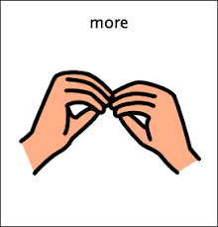
home
Clients might have more than one DSRF appointment. After occupational therapy, it will either be time for a different session or time to go home.
Down Syndrome Resource Foundation | OT

