Slide 1
RAC+
at DSRF
Reading and Communication Plus

Slide 2
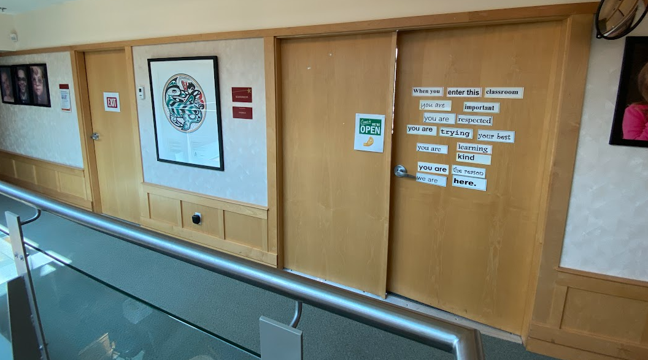
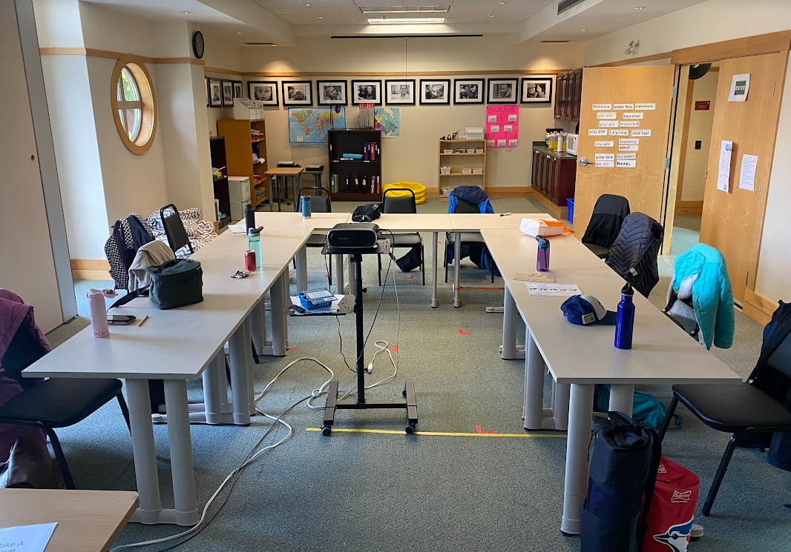
RAC is at DSRF. It is in the classroom upstairs.
Down Syndrome Resource Foundation | RAC at DSRF

Slide 3
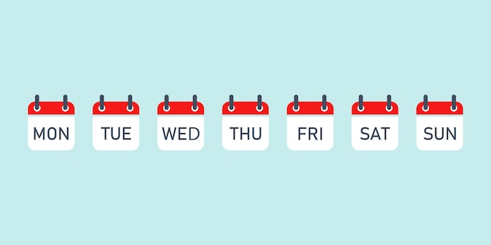
RAC is on Mondays and Wednesdays from 9 am – 3 pm.
Down Syndrome Resource Foundation | RAC at DSRF

Slide 4
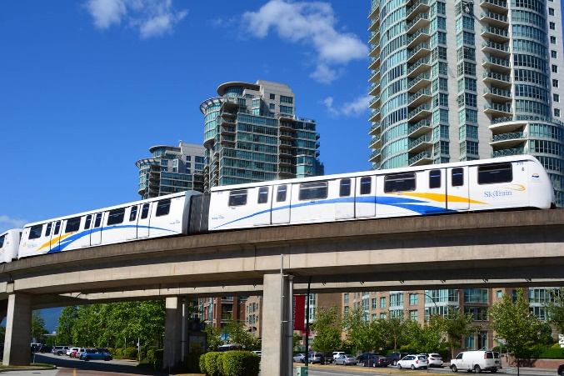
In RAC, students will read, write, do math, and go on class outings.
Down Syndrome Resource Foundation | RAC at DSRF

Slide 5
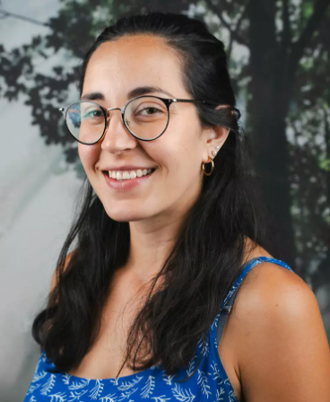
Jeni and Ana are RAC teachers.
Down Syndrome Resource Foundation | RAC at DSRF

Slide 6
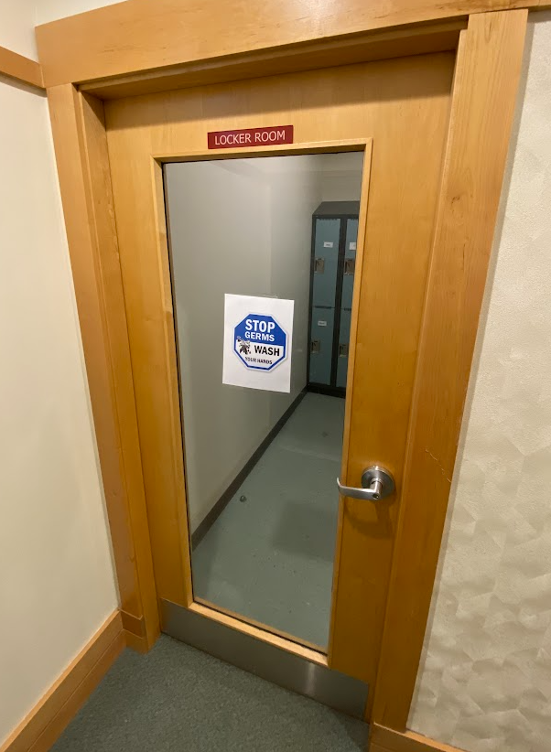
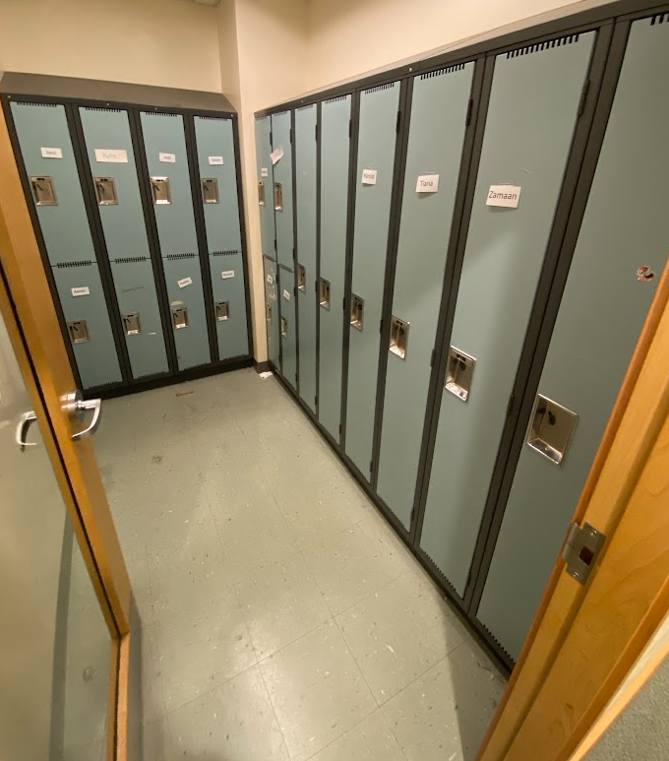
Students get a locker for the school year. Bags are kept in lockers during class.
Down Syndrome Resource Foundation | RAC at DSRF

Slide 7
Break is at 10:30 am. Students can have a snack in the classroom.
Down Syndrome Resource Foundation | RAC at DSRF

Slide 8
Lunch is at 12:00 pm.
Lunch is eaten in the classroom.
Down Syndrome Resource Foundation | RAC at DSRF

Slide 9
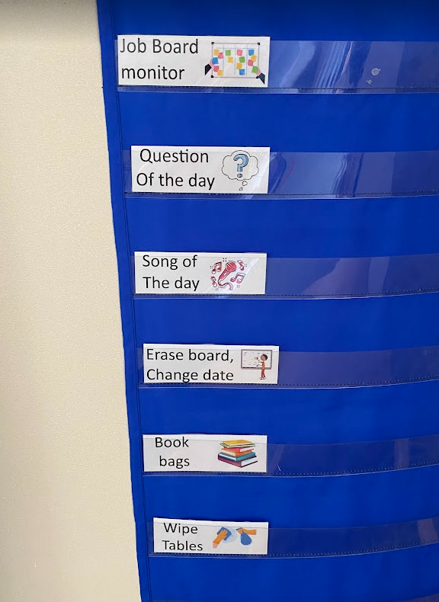
All students help keep the classroom clean and organized. Students get a new job each week.
Down Syndrome Resource Foundation | RAC at DSRF

Slide 10
Students will tell a teacher before they leave the classroom.
Down Syndrome Resource Foundation | RAC at DSRF

Slide 11
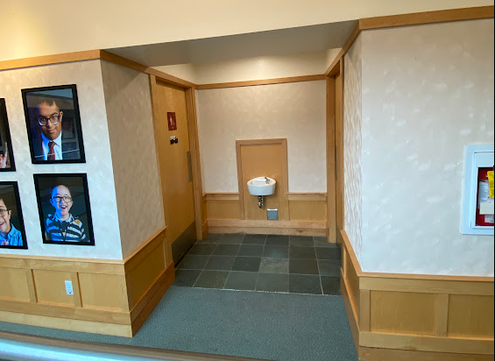
Students use the bathrooms upstairs by the classroom.
Down Syndrome Resource Foundation | RAC at DSRF

Slide 12
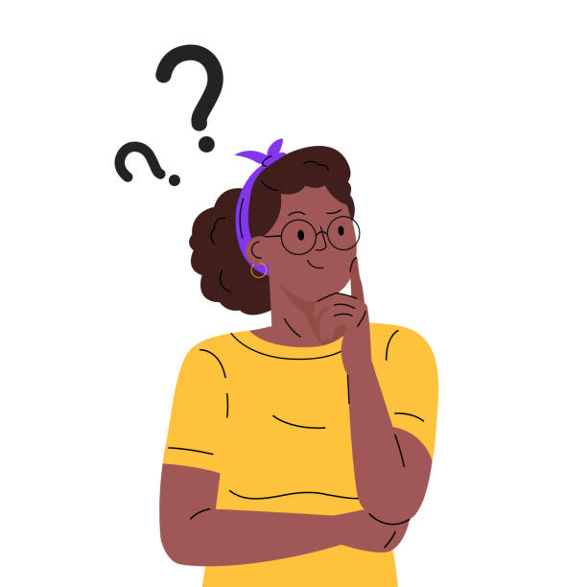
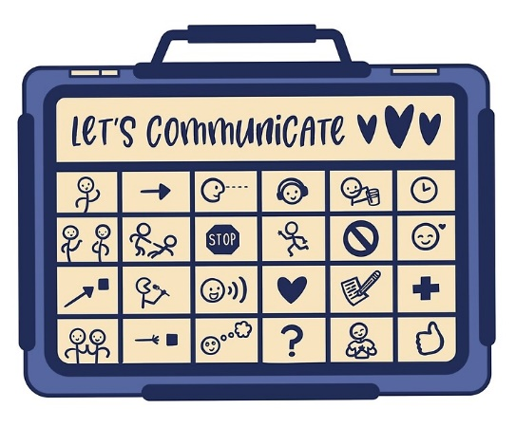
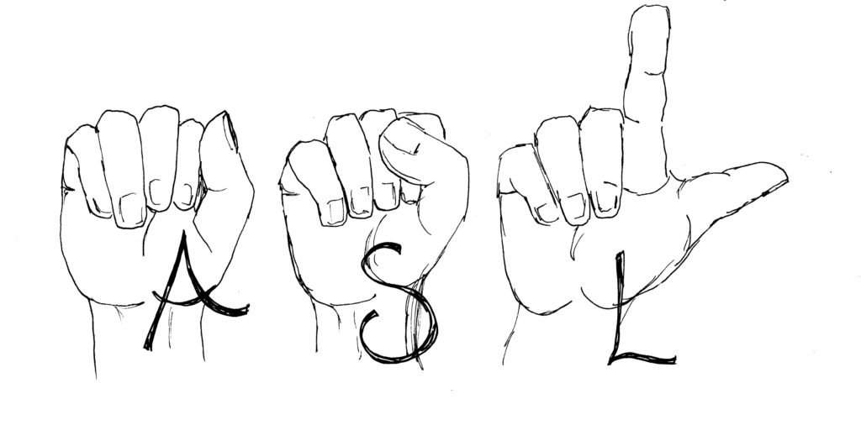
Students use all different kinds of communication. Being kind and curious is important in RAC.
Down Syndrome Resource Foundation | RAC at DSRF

Slide 13
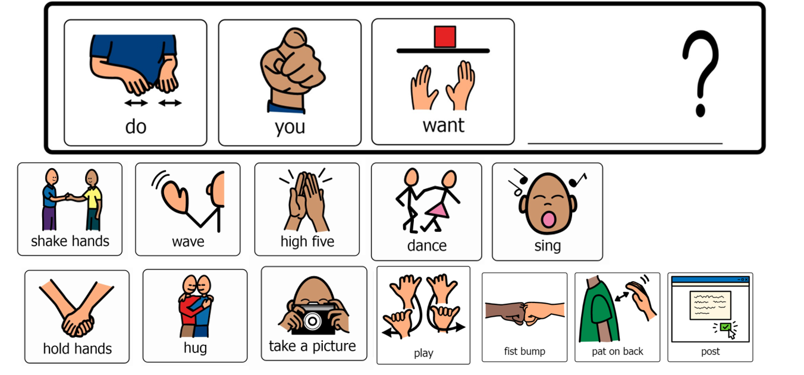
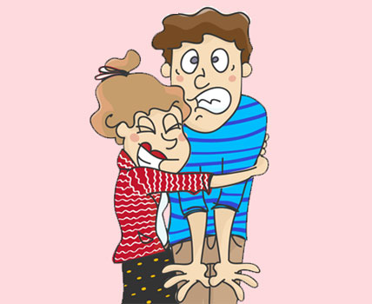
Students can ask for consent before touching peers in class.
Down Syndrome Resource Foundation | RAC at DSRF

Slide 14
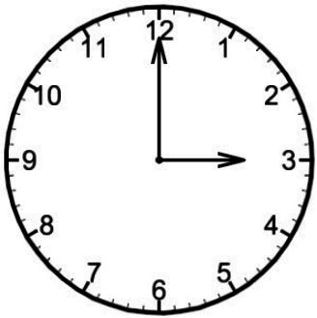
RAC class is over at 3 pm. Students' clean-up and head home.
Down Syndrome Resource Foundation | RAC at DSRF

Slide 15
RAC is a lot of fun! Making new friends in class is exciting.
Down Syndrome Resource Foundation | RAC at DSRF

